Slide 1


By Motlatsi Moea
Date: 6/7/2024

Slide 2

Outline
Executive Summary
Introduction
Methodology
Results
Conclusion
Appendix

Slide 3
Executive Summary
The aim of the project was to investigate if predictive models could be developed to predict if SpaceX’s launches would succeed or fail, and thus determine the cost of each mission.
To achieve this goal, data about SpaceX’s past missions was obtained from SpaceX REST API as well as web scraping the wiki pages.
The data was then processed and cleaned using Python Pandas library, analyzed using SQL, visualized using seaborn and Matplotlib and Folium libraries, as well as creating a dashboard using Plotly and Dash.
Furthermore, the data was used to train a predictive classification algorithm.
What was found was that it would be possible to predict the success or failure of future SpaceX missions using the classification algorithm, thus predicting future costs. However, it is advised that more data be used to train the models for better accuracy
It was also found that SpaceX’s mission successes have been steadily increasing. Meaning, it can be expected to remain competitive for the foreseeable future.

Slide 4
Introduction
We live in an age of commercialized space travel with companies such:
Virgin Galactic
Blue origin
Top of the food chain is SpaceX because of its ability to reuse the first stage of the
Rocket, making the whole process much cheaper.
Problems you want to find answers
Determine the price of each launch Space X will conduct
Predict whether the first stage will be reused or not for each launch

Slide 5

Section 1

Slide 6
Methodology
Executive Summary
Data collection methodology:
Data was collected from the SpaceX REST API as well as scrapping SpaceX wiki Pages
Perform data wrangling
Python Pandas library was used to clean, process and analyze the data as required
Perform exploratory data analysis (EDA) using visualization and SQL
Perform interactive visual analytics using Folium and Plotly Dash
Perform predictive analysis using classification models
The scikit-learn library was used to build and test out different classification predictive models and the accuracy of the various models compared.

Slide 7
Data Collection
The data for this project was collected using a SpaceX REST API. This provided data about the rocket launches, including:
Information about rocked used;
Payload carried;
Launch & landing specifications
Landing outcome
Another method that can be used to collect this data is by web scraping some related wiki pages using beautiful soup for Falcon 9 launch data.

Slide 8
Data Collection – SpaceX API
https://github.com/motlatsimoea/final_exam/blob/main/jupyter-labs-spacex-data-collection-api.ipynb
Send ‘GET' request to SpaceX API
Get JSON Formatted Data
Normalize and Convert into Pandas Data Frame for cleaning and analysis

Slide 9
Data Collection - Scraping
https://github.com/motlatsimoea/final_exam/blob/main/jupyter-labs-webscraping.ipynb
Request a wiki page from the URL
Get HTML for the page
Parse the html using Beautiful soup
Use the Beautiful soup library to collect the relevant data
Store data in pandas Data Frame for data wrangling and analysis

Slide 10
Data Wrangling
An overview of the data was conducted, in order to get a better understanding of the various attributes of the data, and to identify the target column, which was the ‘Outcome’.
This Target was categorical with multiple categories indicating success and failure outcomes. These needed to be converted into numerical values. (0 for failed and 1 for success.)
https://github.com/motlatsimoea/final_exam/blob/main/labs-jupyter-spacex-Data%20wrangling.ipynb
Overview of Attributes
Assess for missing values
Identify Target column
Convert target column into numerical values

Slide 11
EDA with Data Visualization
The different variables were visualized using scatter plots. The goal was to understand the relationships between the different variable and how they impacted the target column(Outcome).
The variables were plotted and separated by the ‘Outcome’ category(0:failure, 1: success)
Bar plot was also used for the success rate for each Orbit Type
https://github.com/motlatsimoea/final_exam/blob/main/edadataviz.ipynb

Slide 12
EDA with SQL
With the data stored in a database, it was explored using SQL. The goal was to obtain information that included:
Different Launch sites used;
The total payload carried for all missions;
Average payload carried by Booster version F9 v1.1;
Total missions that succeeded and failed;
Sum of each of the landing outcomes;
Etc.
https://github.com/motlatsimoea/final_exam/blob/main/jupyter-labs-eda-sql-coursera_sqllite.ipynb

Slide 13
Build an Interactive Map with Folium
A map was created using Folium to visually display the launch sites.
Markers circles were used to mark the different launch sites on the map;
Cluster markers were used to show the successful and failed missions for each site;
The closest highway, city, railway and coastlines were highlighted on the map using lines.
https://github.com/motlatsimoea/final_exam/blob/main/lab_jupyter_launch_site_location.ipynb

Slide 14
Build a Dashboard with Plotly Dash
A dashboard was created using dash. This Dashboard included:
A pie chart giving a summary of the success rate for each launch site;
There is a dropdown menu to allow the user to see results for a specific site
A scatter plot that shows the relationship between the payload size and the Outcome.
A slider was added to allow user to adjust the range of the payload for visualization.
https://github.com/motlatsimoea/final_exam/tree/main/dash

Slide 15
Predictive Analysis (Classification)
The data was standardized so the impact of all features is properly assessed.
Data was then split into test and train data. 20% of the data as for testing
For the various models tested, Grid search validation was used with various options for parameters to find the optimal ones using training data
The models were evaluated using test data and a confusion matrix was visualized to assess model accuracy
https://github.com/motlatsimoea/final_exam/blob/main/SpaceX_Machine%20Learning%20Prediction_Part_5.ipynb
Data Standardization
Split data into train and test datasets
Grid search with training data to find optimum model parameters
Evaluate model using test data

Slide 16
Results
Exploratory data analysis results
Interactive analytics demo in screenshots
Predictive analysis results

Slide 17

Section 2

Slide 18
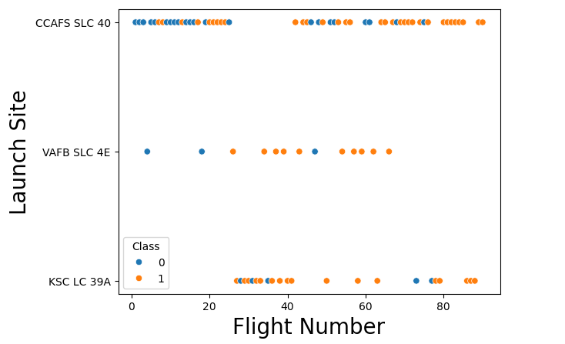
Flight Number vs. Launch Site
From the plot, it can be observed that CCAFS SLC 40 is used for most launches;
VAFB SLC 4E has the least number of launches;
At least the last 5 launches from all sites were successful. In some cases, more.
VAFB SLC 4E seems to have the highest success ratio, although also least number of launches

Slide 19
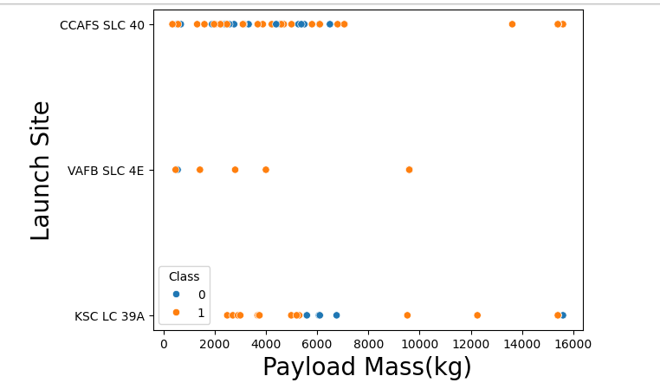
Payload vs. Launch Site
CCAFS SLC 40 launch site seems to have a mix of failures and successes for payload between 0 and 8000kg. For the larger loads of over 12000kg, the launches have been successful;
VAFB SLC 4E seems to be used for lighter payload between 0 and 10000kg, resulting in the all but one launch being successful.

Slide 20
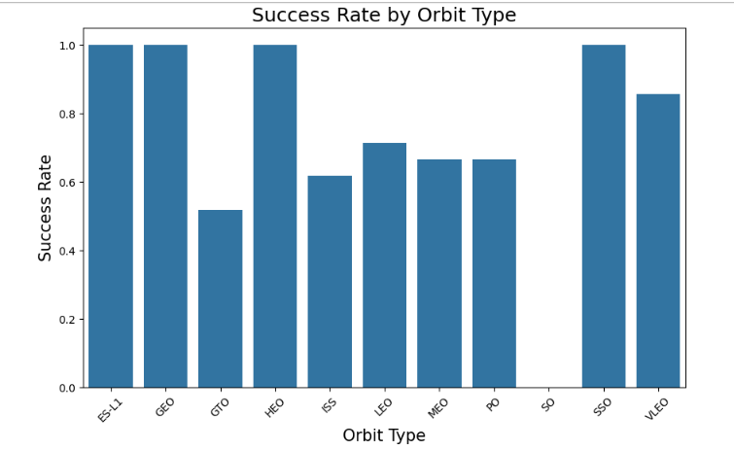
Success Rate vs. Orbit Type
ES-L1, GEO, HEO, SSO have the highest success rate of 100%
Followed by LEO with around 70%, MEO and PO just below that and the lowest being GTO at around 50%.

Slide 21
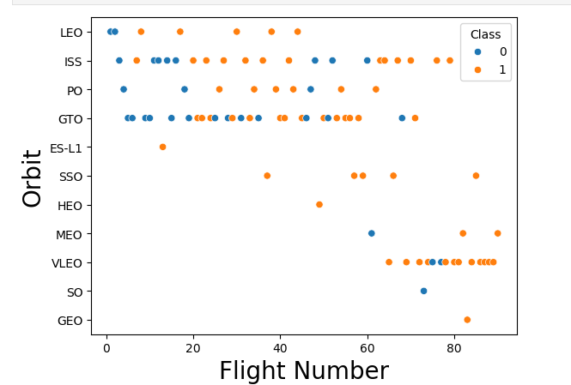
Flight Number vs. Orbit Type
As the flight number increases, the amount of successful travel to different obits increases;
ISS and GTO have been visited more often than other obits;
ES-L1 and GEO only had one flight each. These were successful.

Slide 22
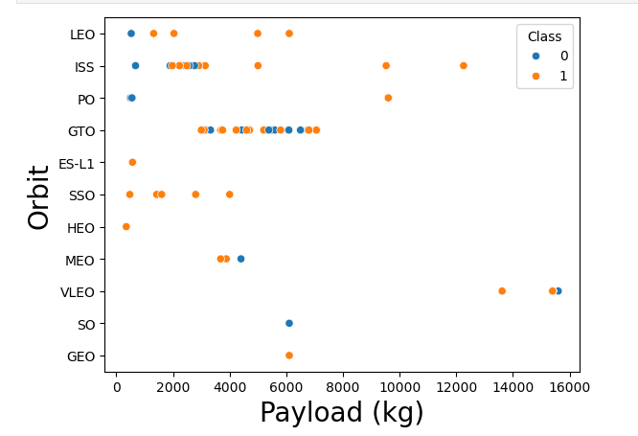
Payload vs. Orbit Type
Payloads between 0 and 4000kg were taken to SSO with all missions being successful;
GTO had payloads between 3000kg and less than 8000kg and were a mix of failures and success.

Slide 23
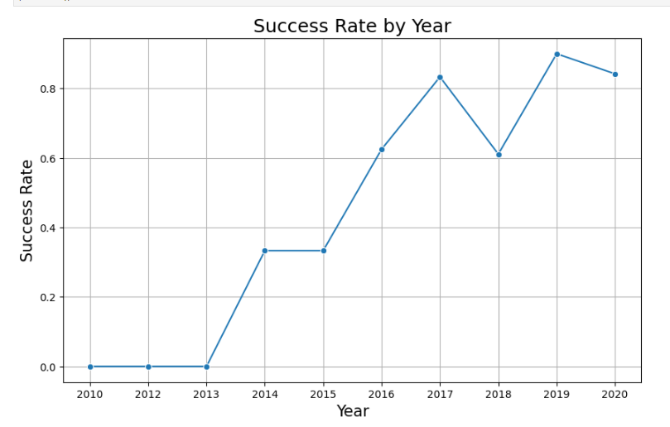
Launch Success Yearly Trend
After the first 3 years, the number success rate of the launches has been rising linearly with a some notable drops in 2018 and 2020.

Slide 24
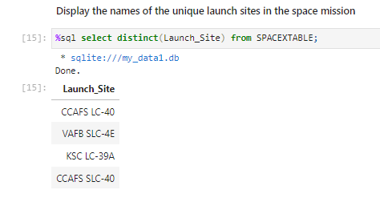
All Launch Site Names
This was the SQL query that was used to retrieve the unique launch sites.

Slide 25
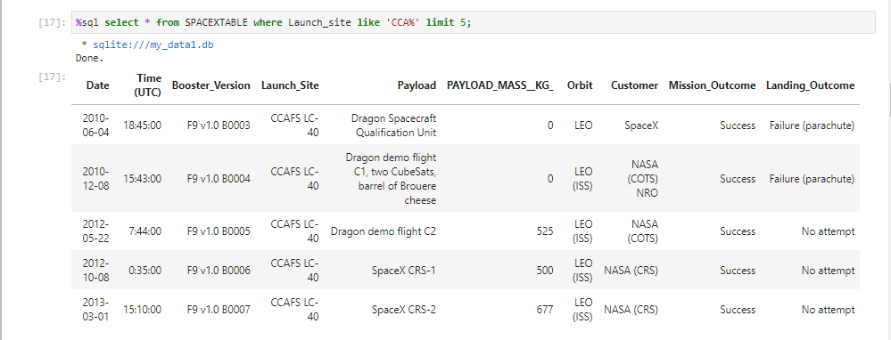
Launch Site Names Begin with 'CCA'
This is the SQL query and the top 5 results that came with it.

Slide 26
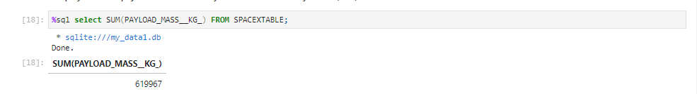
Total Payload Mass
The query to calculate the total payload mass is shown above with the resulting value.

Slide 27
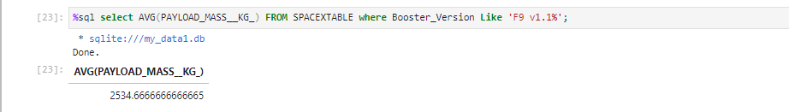
Average Payload Mass by F9 v1.1
The average payload mass carried by booster version F9 v1.1

Slide 28
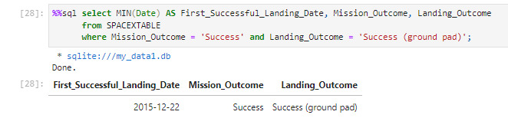
First Successful Ground Landing Date
Query giving the date for the first successful ground landing

Slide 29
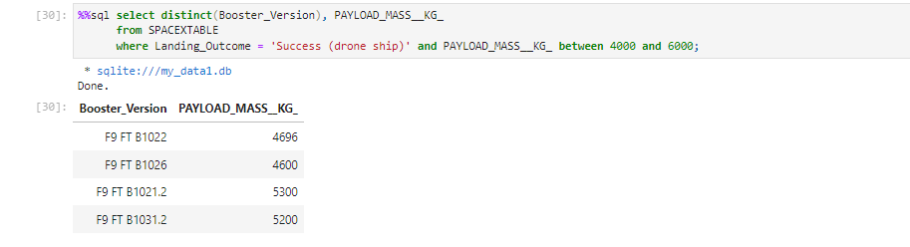
Successful Drone Ship Landing with Payload between 4000 and 6000
These are the 4 boosters the landed successfully with the Payload range.

Slide 30
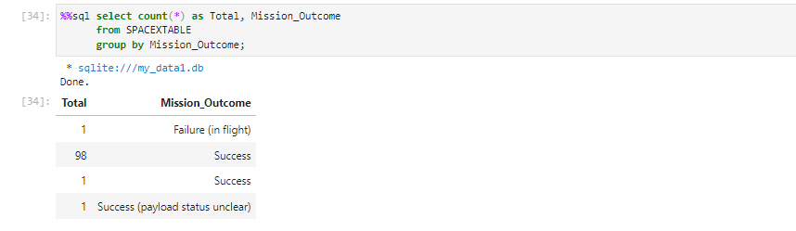
Total Number of Successful and Failure Mission Outcomes
The query above shows the results. There might need to be some data cleaning to dealing with second and third results

Slide 31
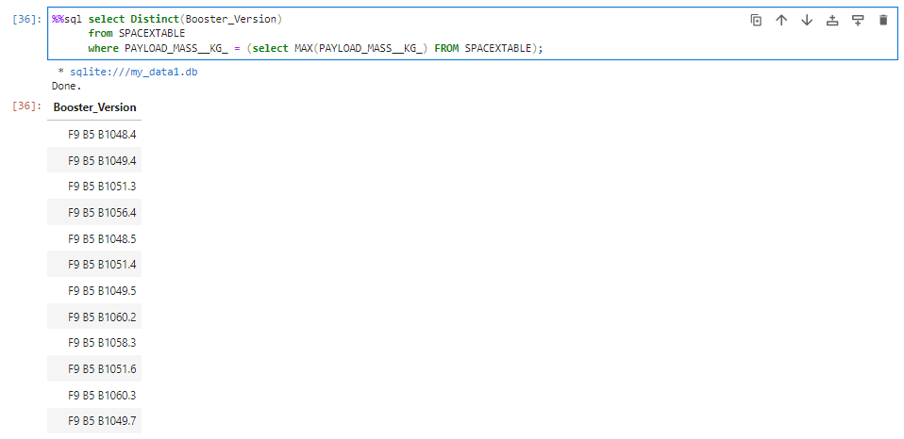
Boosters Carried Maximum Payload
There are about 12 booster versions that have carried the maximum payload.

Slide 32
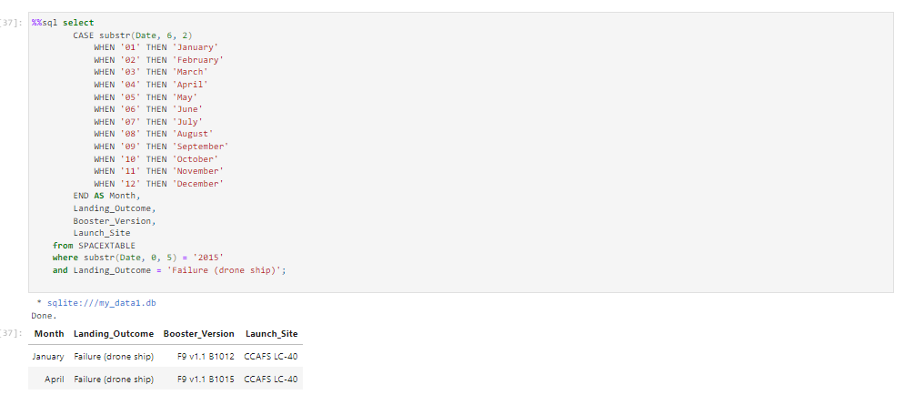
2015 Launch Records
There were only two records that were found to meet this criteria where the landing outcome was Failure landing outcome in drone ships

Slide 33
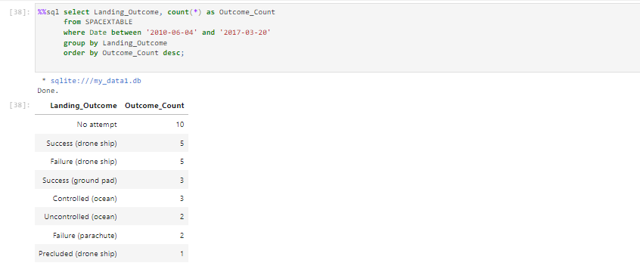
Rank Landing Outcomes Between 2010-06-04 and 2017-03-20
The result for the query is shown above. The outcome are in descending order.

Slide 34

Section 3

Slide 35
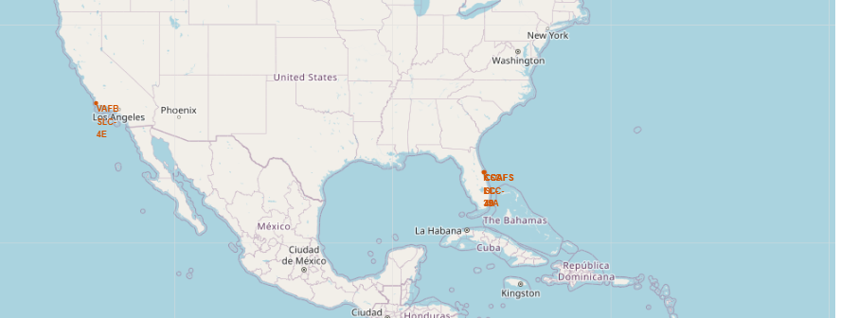
Launch Sites on a global map
They are located in remote areas
All the sites seem to be located near the ocean;
None of the sites appear to be near the equator;

Slide 36
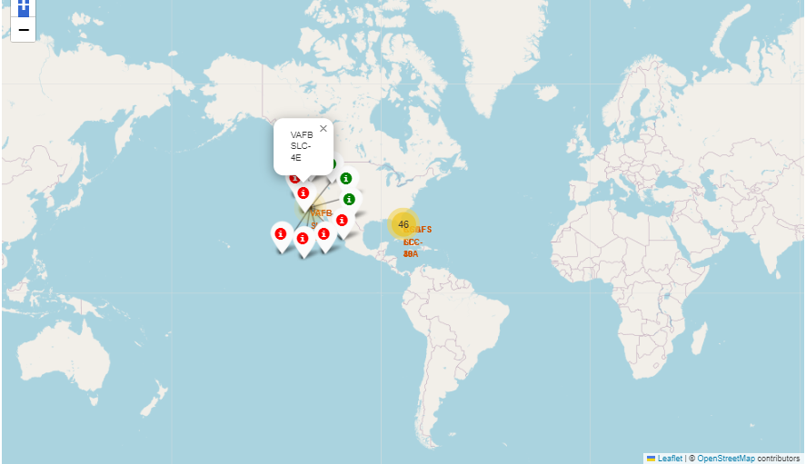
Success and failure indicators
The image shows one of the sites(VAFB SL 4E);
In this image, we can see the number of successful launches conducted here(green) and those which failed(red);
The same information can be found by clicking on the various sites as well

Slide 37
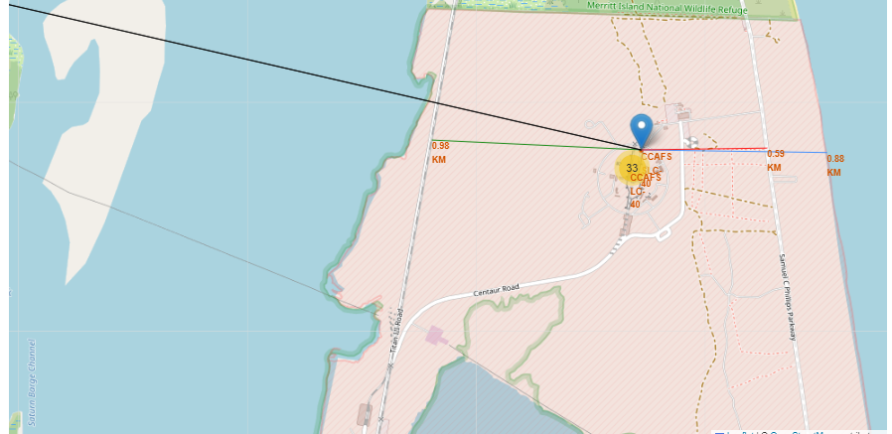
Distances of key areas from CCAFS SLC-40 Site
The image shows the distance of the nearest railway, highway, coastal area and city from the CCAFS SLC-40 site;
The site is relatively close to a working highway, railroad and coastal line, but very far from closest city.

Slide 38

Section 4

Slide 39
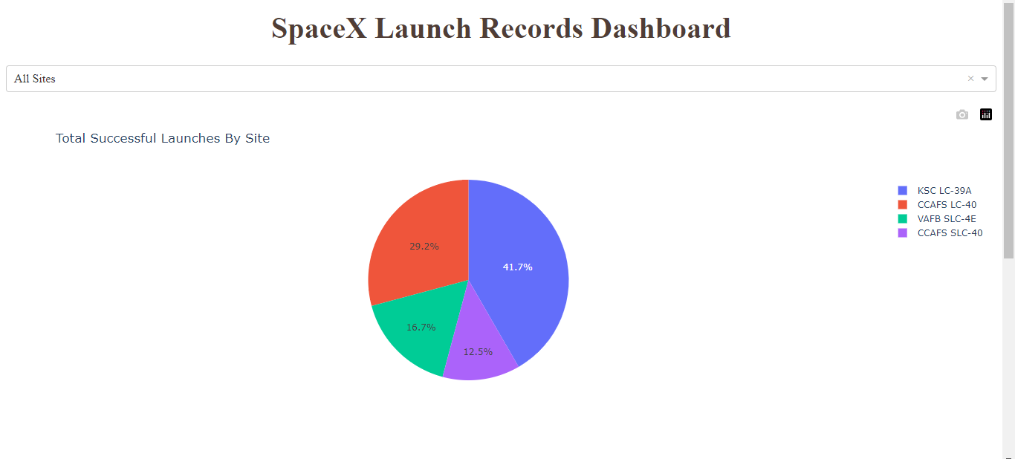
Pie Chart Showing success for various Sites
This dashboard image shows the success rate of all the Launch sites on a pie chart.
KSC LC-39A boasts the overall highest success rate at 41.7% and CCAFS SLC-40 the lowest at 12.5%

Slide 40
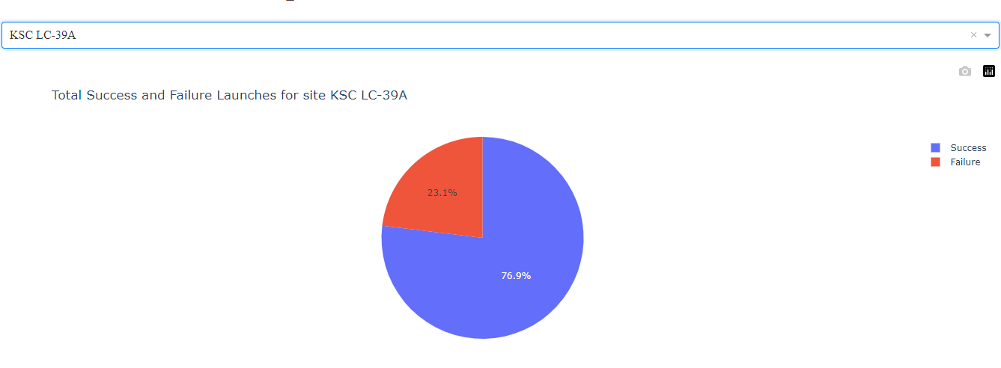
Launch site with the highest Success ratio
The pie chart above shows KSC LC-39A, which has the highest success ratio of all the launch sites used.

Slide 41
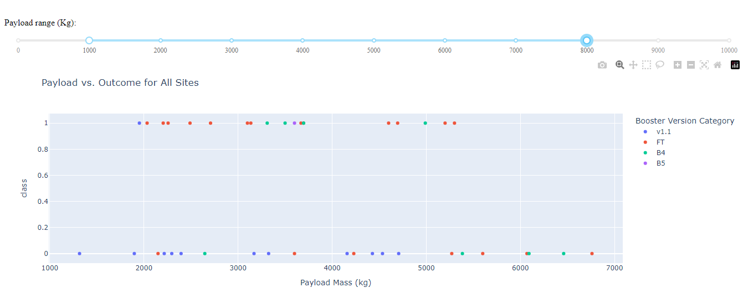
Launch outcomes for different Boosters at various Payloads
For the particular Payload ranges provided, the Booster with the highest success is the FT booster.
The v1.1 seems to have the highest failures

Slide 42

Section 5

Slide 43
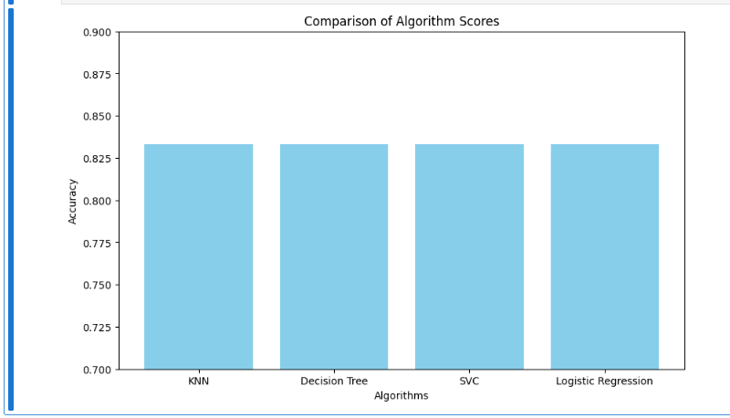
Classification Accuracy
When the models were tested on the test set, they all seem to have similar accuracy score.
Decision trees can be visually easy to explain visually so it would be used.

Slide 44
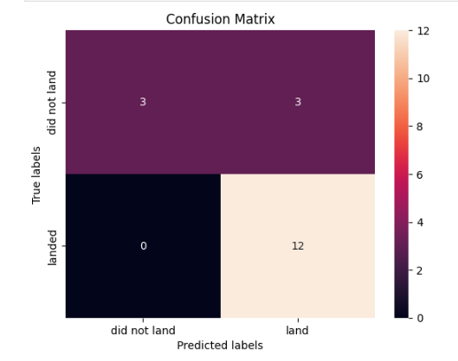
Confusion Matrix
The algorithm seems to have 100% ability to detect the landing outcome.
There seems to be 50% chance of misclassifying the ‘did not land’ instances as landing.

Slide 45
Conclusions
The algorithms could be used predict if a launch will be a success or not. However, the ability to detect failed launched needs to be improved
The Dataset used to train the models needs to be increased to improve model accuracy.
SpaceX seems to have a lot more successful launches with time. This means we might expect their costs to remain competitive in the future.

Slide 46
Appendix
SQL queries: https://github.com/motlatsimoea/final_exam/blob/main/jupyter-labs-eda-sql-coursera_sqllite.ipynb
Visualzation charts: https://github.com/motlatsimoea/final_exam/blob/main/edadataviz.ipynb
Code for model training: https://github.com/motlatsimoea/final_exam/blob/main/SpaceX_Machine%20Learning%20Prediction_Part_5.ipynb
Rest of the files: https://github.com/motlatsimoea/final_exam/tree/main/dash
Code for dashboard: https://github.com/motlatsimoea/final_exam/blob/main/dash.txt

Slide 47


